Slide 1
How Technology Transformed Art: From Cel Animation to Modern Digital Media
Baney Montoya CSIT 100 11/24/25

Slide 2
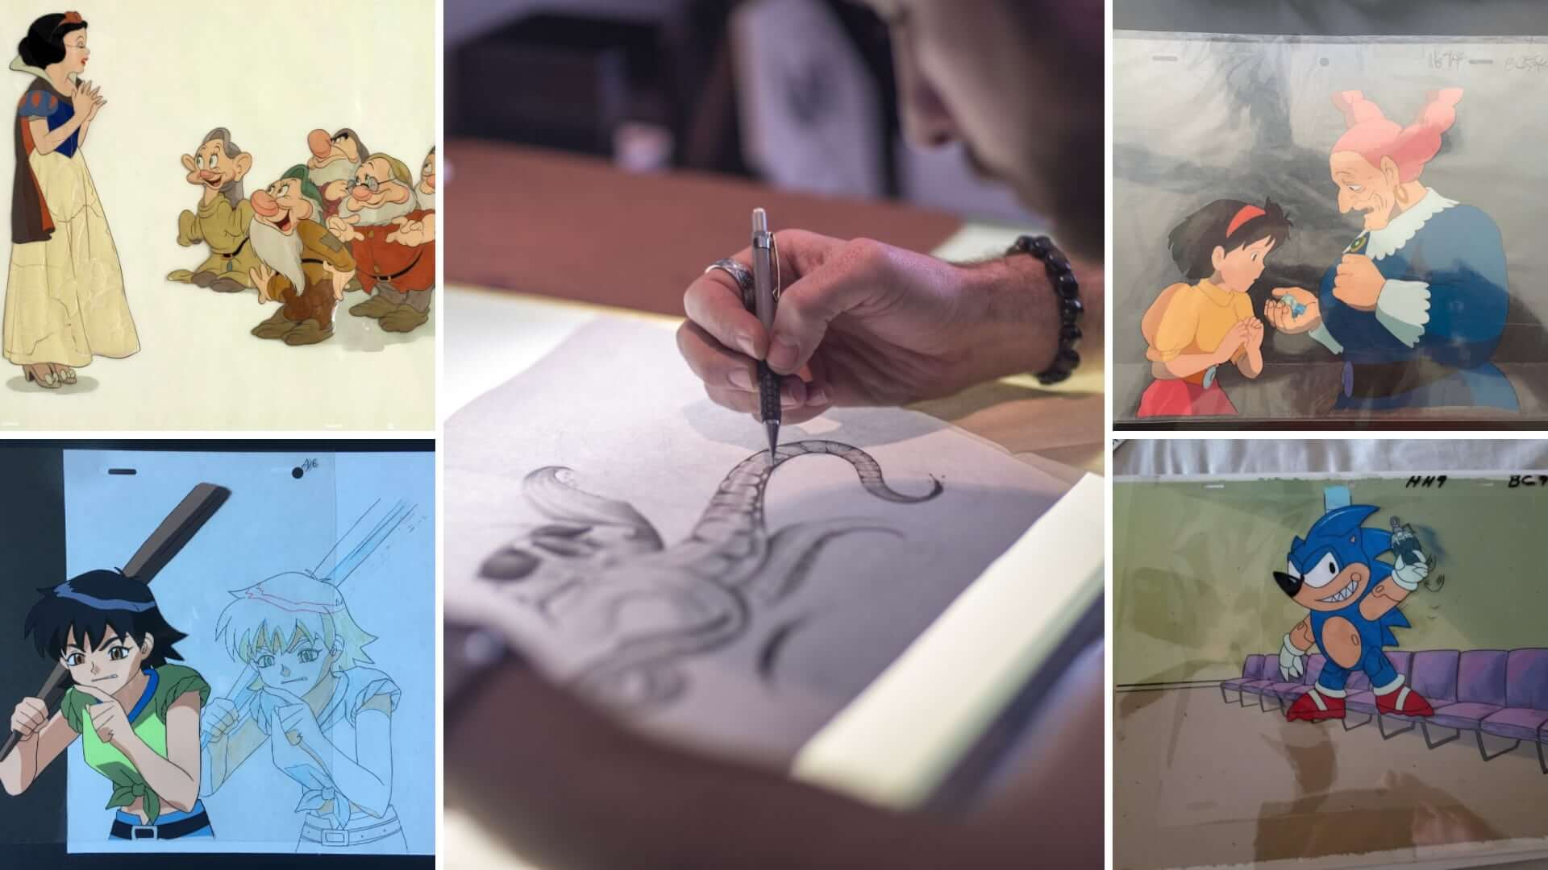
Introduction
Throughout the twentieth and twenty-first centuries, technology has transformed how art is created, shared, and understood. The shift from hand-drawn cel animation to digital media shows how artistic methods continuously adapt as new tools emerge.

Slide 3
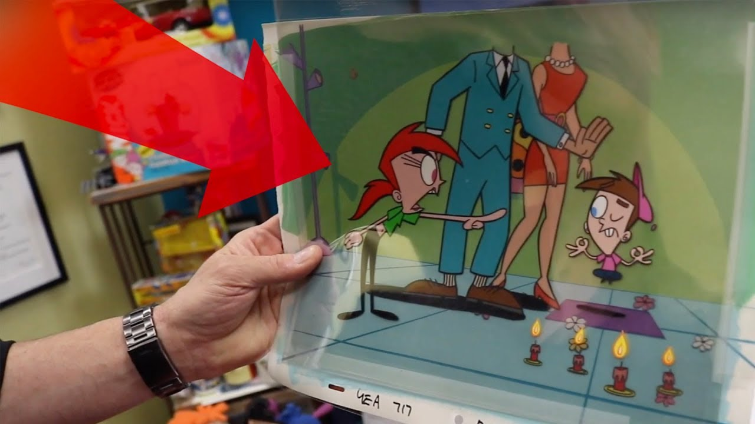
Early Animation Technology
Early animation relied on cel animation, where artists drew thousands of images on transparent sheets. This method allowed layers to be photographed together one frame at a time, creating motion through painstaking manual labor and early mechanical technology.

Slide 4
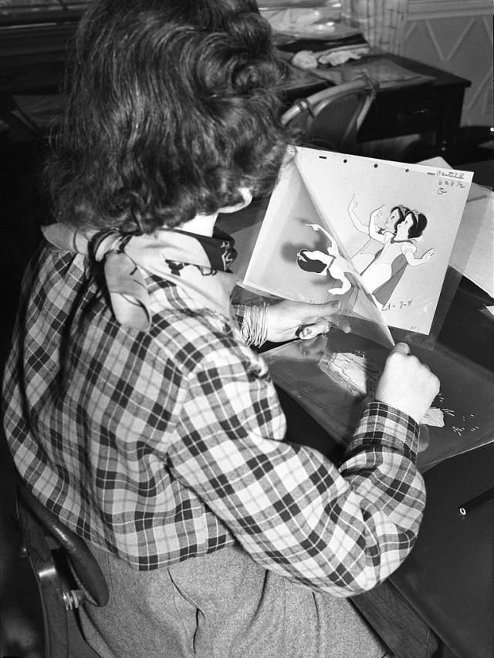
Cel Animation In Practice
Cel animation demanded exceptional artistic skill and precise coordination. Studios like Disney used techniques such as the multiplane camera to add depth, but the process still required thousands of drawings, complex lighting setups, and large teams of artists.

Slide 5
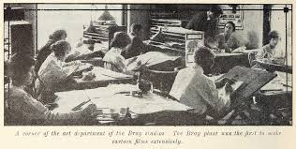
Limits of Traditional Techniques
Traditional animation involved costly materials, time-consuming revisions, and enormous labor demands. Even small errors required scenes to be redrawn. These limitations pushed artists and studios to seek more efficient alternatives as digital technology advanced.

Slide 6
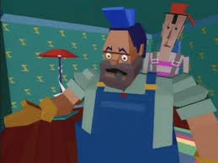
Early Computer-Assisted Animation
From the 1960s to the 1980s, pioneers like John Whitney experimented with computer graphics. Though primitive by today’s standards, early digital animation research laid the foundation for integrating computers into creative workflows.

Slide 7
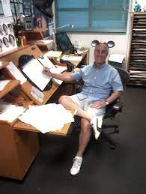
Digital Ink & Paint Systems
The development of systems like Disney’s CAPS in the 1980s–1990s revolutionized animation. Artists scanned drawings into computers, applied digital ink and paint, and composited images with new precision, reducing physical labor while enhancing creative control.

Slide 8
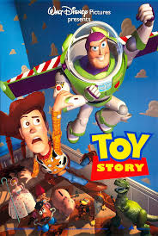
Rise of CGI
The mid-1990s brought CGI into mainstream art, beginning with fully 3D animated films. Artists shifted from drawing frames to building 3D models, rigging digital characters, and animating them in virtual environments, opening vast creative possibilities.

Slide 9
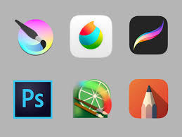
Digital Illustration Tools
Digital illustration tools such as Photoshop, Corel Painter, and Procreate changed art by offering layers, unlimited undo, and digital brushes. Tablets and touchscreens made digital painting intuitive, lowering barriers for new artists worldwide.

Slide 10
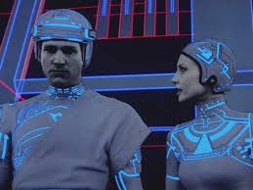
Visual Effects & Hybrid Art
Modern art often blends live-action footage with CGI using green screens, motion capture, and advanced compositing. These hybrid methods combine traditional cinematography with digital effects to create immersive multimedia experiences.

Slide 11
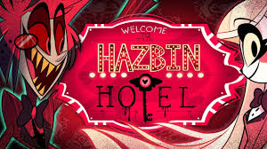
The Internet Influence
The internet transformed how art is shared and consumed. Artists now reach global audiences instantly, learn from online tutorials, collaborate internationally, and build careers through digital commissions and online marketplaces.

Slide 12
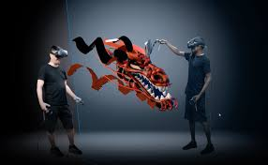
VR & AR Art
VR allows artists to create immersive 3D environments, while AR overlays digital art onto the real world. These technologies shift art from static images to interactive experiences that respond to viewer movement and space.

Slide 13
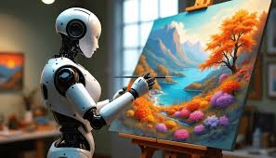
Generative & AI Art
AI tools can analyze artistic patterns and generate new imagery. While controversial, these systems help artists brainstorm, experiment quickly, and explore new concepts, raising questions about authorship and the role of human creativity.

Slide 14
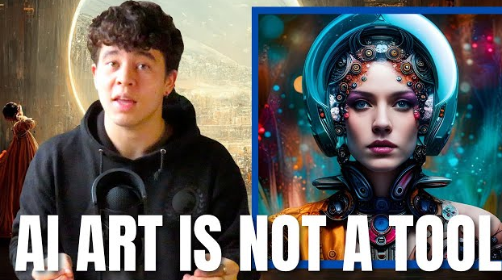
Cultural & Creative Impact
Technology expanded creative opportunities, democratized art tools, and enabled digital preservation. Yet it also introduced challenges like copyright concerns and rapid software changes that artists must continually adapt to.

Slide 15
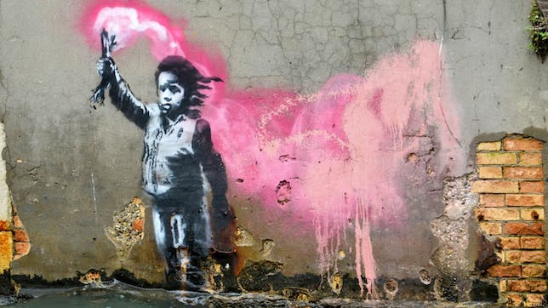
Conclusion
The evolution from cel animation to digital and AI-driven art shows that while tools evolve, creativity remains essential. Technology broadens artistic potential, shaping the future of how people imagine, create, and experience art.

